Slide 1
Lead Hand Off Escalation
Website, SALT & SEG Leads

Slide 2
Process
When a Lead is Passed from Davis to a Site:
Task Created Immediately on the contact record
24 Hours: Site must Accept the Lead (Complete the Task)
48 Hours: If not accepted, General Manager is notified
72 Hours: VP of Sales is notified
96 Hours: If still not accepted, Lead returns to Davis for reassignment

Slide 3
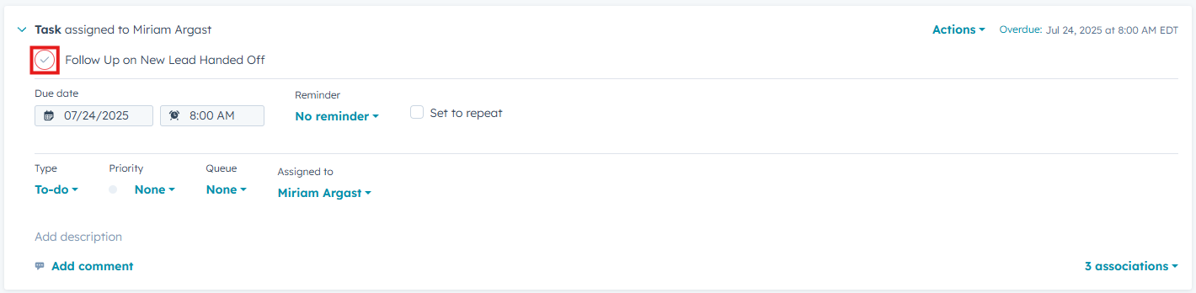
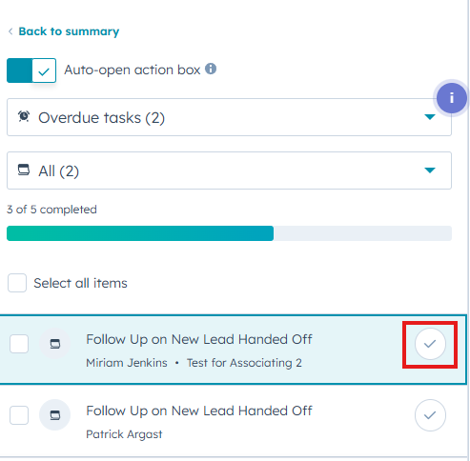
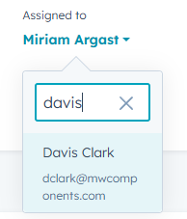
Task Assignment & Completion
Complete the Task on the Contact Record
Complete the Task in the Sales Workspace
Complete the Task on the Task Page
If this is a “No Quote” for your site, assign Task to Davis

Slide 4
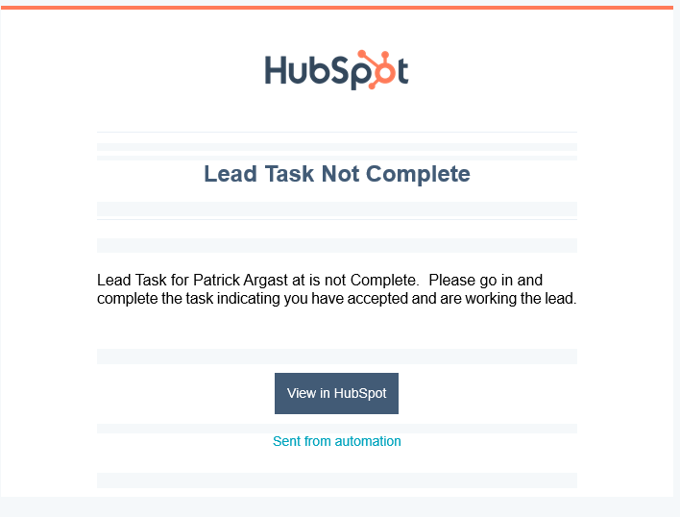
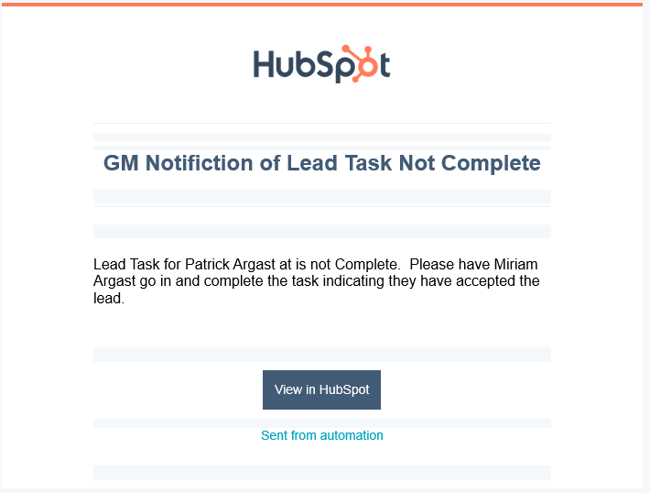
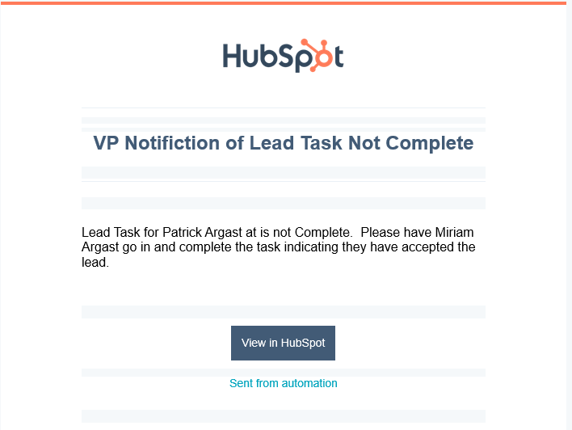
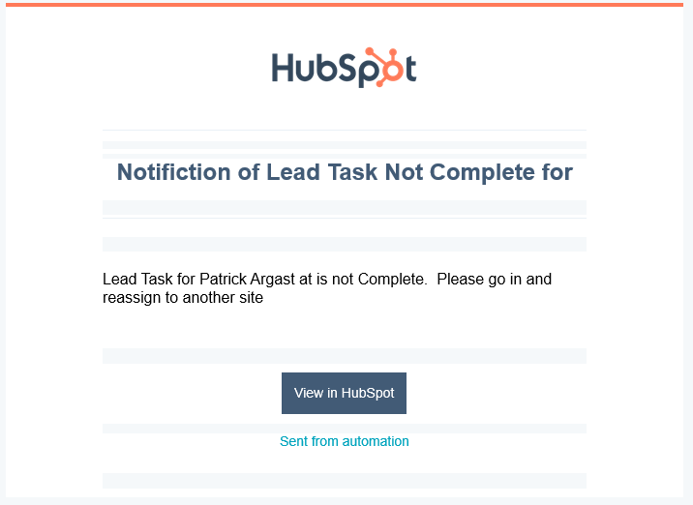
Escalation Emails
Email to Lead Owner If Task is not complete within 24 hours
Email to General Manager if Task is not complete within 48 hours
Email to VP of Sales if Task is not complete within 72 hours
Email back to SDR to reassign to another location after 96 hours

Slide 5

How to Video

